Slide 1
PHYS4260 Quantum Mechanics II Spring 2025
Symmetries and Conservation laws

Slide 2
Outline
Rotations
Translations
Conservation Laws (Translations)
Bloch’s theorem

Slide 3
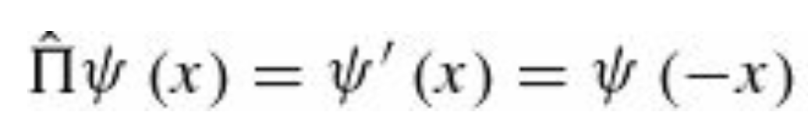
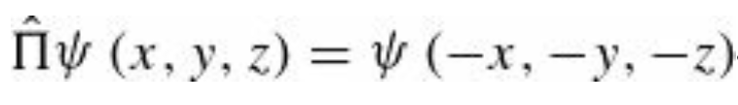
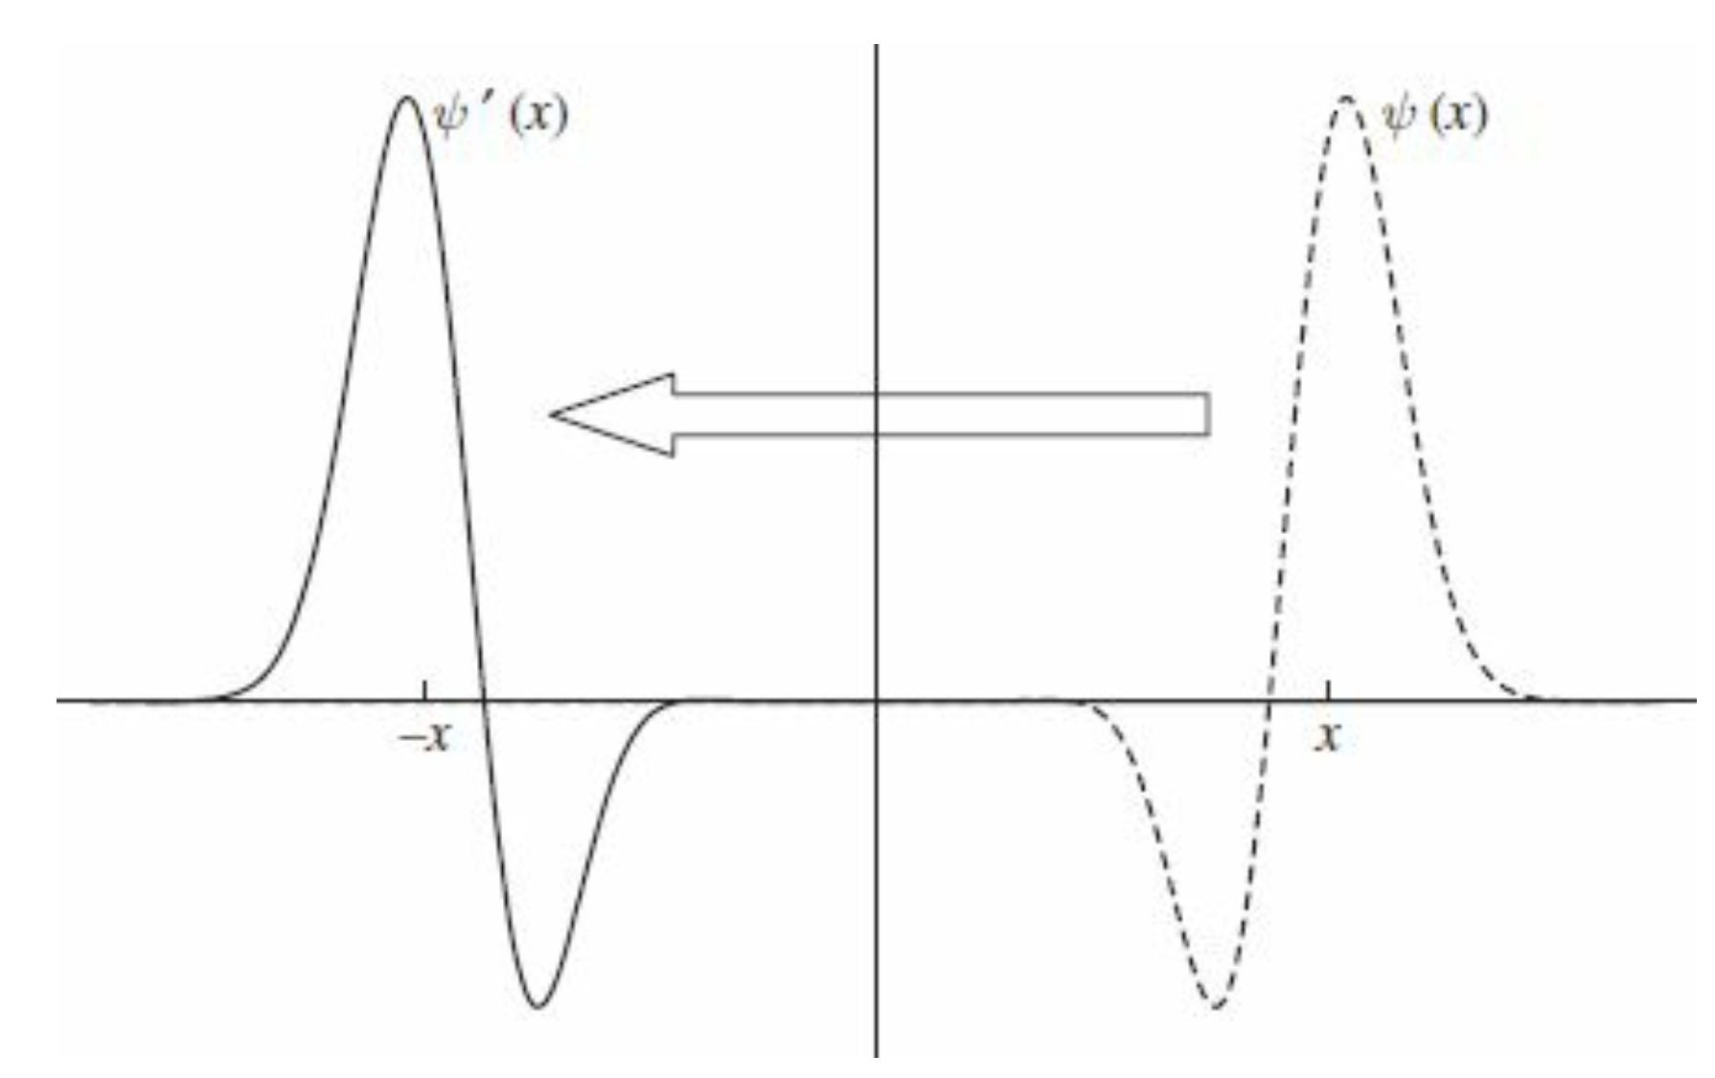
Recap: Transformations in space: Inversions
The operator that reflects a function about the origin, the parity operator in one dimension, is defined by
The effect of parity is shown graphically below. In 3-dim, parity changes the sign of all three coordinates
The parity operation in three dimensions can be realized as a mirror
reflection followed by a rotation
In two dimensions, the transformation $ψ^{′}\left(x,y\right)=ψ(−x,−y)$ is no
different from a $π$ angle rotation.
We will use the term parity exclusively for spatial inversion
in one or three dimensions.

Slide 4
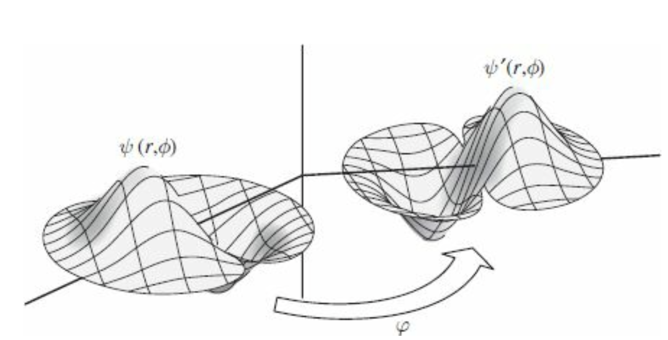

Transformations in space: Rotations
Finally, the operator that rotates a function about the $z$ axis through an angle $φ$ is most naturally expressed in polar coordinates as
We will introduce expressions for rotations about arbitrary axes. The action of the rotation operator on a function is
illustrated here in the figure below.
A function and the rotated function
after a counter-clockwise rotation about the vertical axis by an angle $φ$

Slide 5
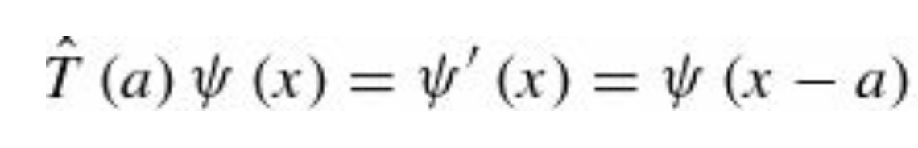
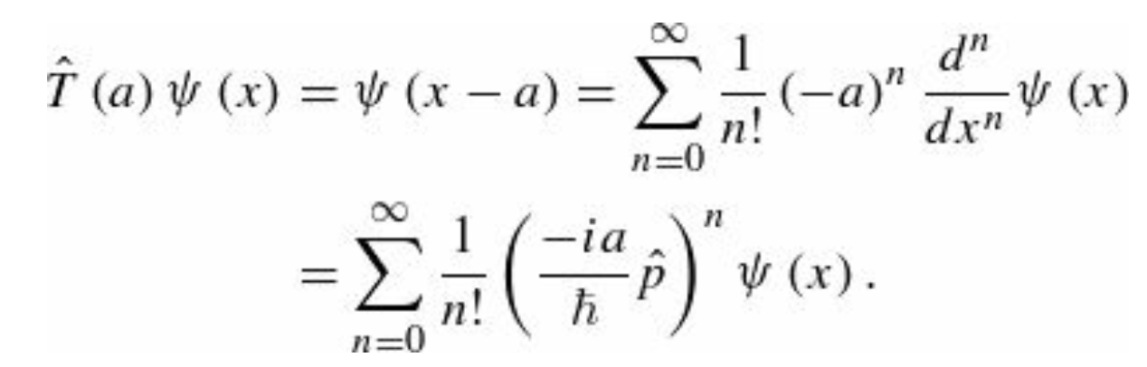
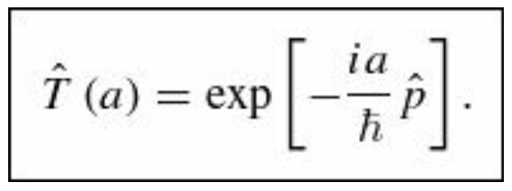
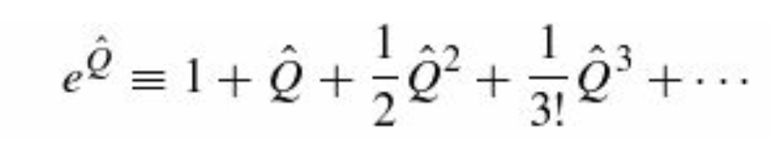
Translations: the translations operator
We can express the translation operator $\hat{T}(a)$ in terms of the momentum operator, to which it is intimately related.
To that end, we replace $ψ\left(x−a\right)$ by its Taylor Series. Therefore, we obtain ($ψ\left(x−a\right)=ψ(x_{0}+∆x)$; $x≡x_{0}$ and $∆x=−a$ )
The right-hand side of this equation is the
exponential function

Slide 6
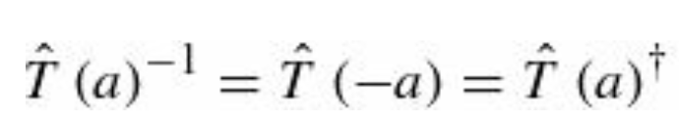
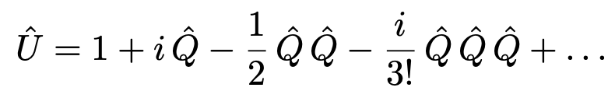
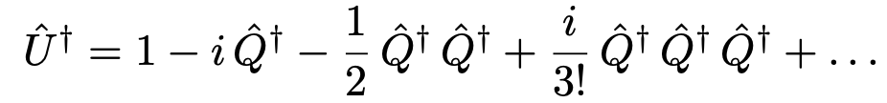
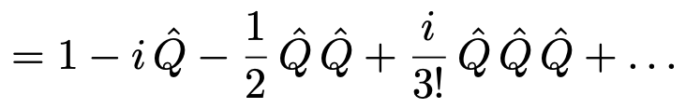
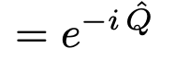
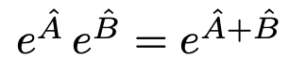
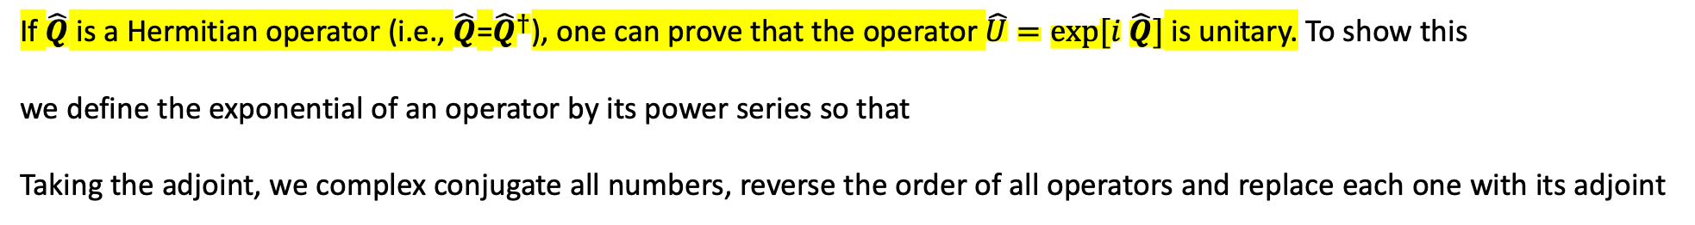
Translations: the translations operator
In the previous expression, we used the QM postulate
We say that the momentum operator $\hat{T}(a)$ is the “generator” of translations, and that is a unitary operator.
A unitary operator is one whose adjoint is also its inverse
If $\hat{Q}$ is a Hermitian operator (i.e., $\hat{Q}$=${\hat{Q}}^{†}$), one can prove that the operator $\hat{U}=exp⁡[i \hat{Q}]$ is unitary. To show this
we define the exponential of an operator by its power series so that
Taking the adjoint, we complex conjugate all numbers, reverse the order of all operators and replace each one with its adjoint
if A and B commute. Since $iQ$ clearly commutes with $–i Q$ then

Slide 7
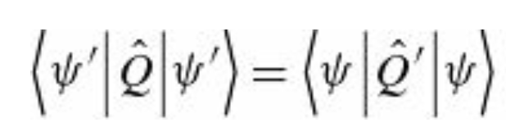
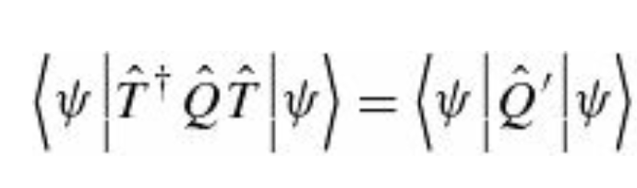
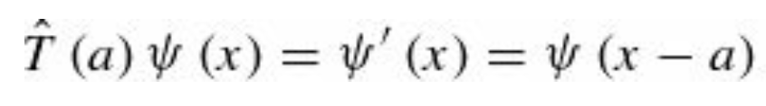
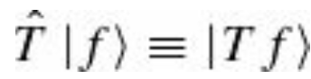
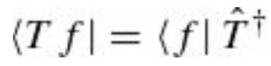
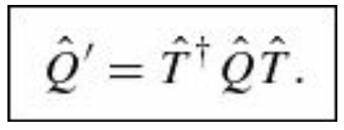
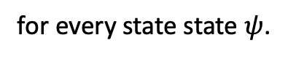
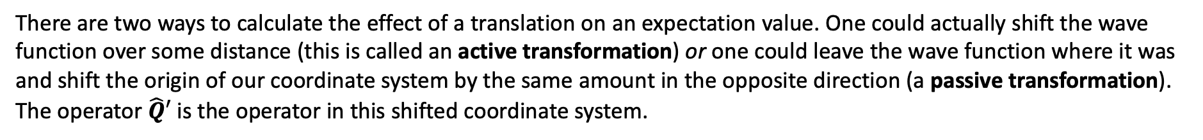
How operators transform (translations)
So far, we have shown how to translate a function. We can also consider what it means to translate an operator.
The transformed operator $\hat{Q}′$ is defined to be the operator that gives the same expectation value in the untranslated
state $ψ$ as does the operator $\hat{Q}$ in the translated state $ψ$’
There are two ways to calculate the effect of a translation on an expectation value. One could actually shift the wave
function over some distance (this is called an active transformation) or one could leave the wave function where it was
and shift the origin of our coordinate system by the same amount in the opposite direction (a passive transformation).
The operator $\hat{Q}′$ is the operator in this shifted coordinate system.
for every state state $ψ$.
Here we are using the fact that and from which

Slide 8
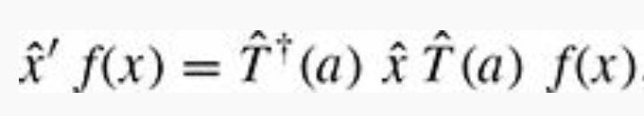
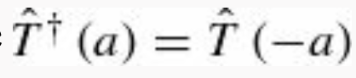
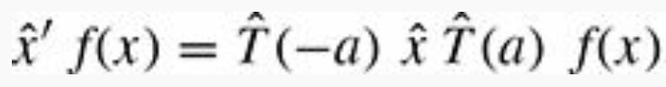
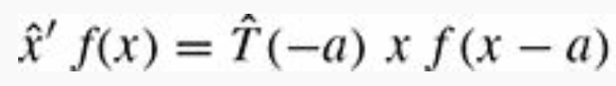
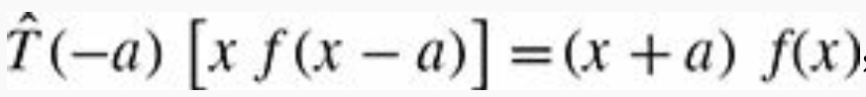
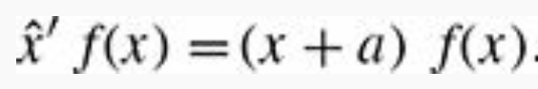
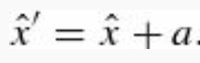

Example 1: $\hat{Q}$= $\hat{x}$
Let’s try to find the operator $\hat{x}′$ obtained by applying a translation through a distance $a$ to the operator $\hat{x}$. That is, let’s try
To find the action of $\hat{x}′$ is on an arbitrary function $f(x)$
Therefore, we obtain
And finally, we may read off the operator
corresponds to shifting the origin of our coordinates to the left by a so that positions in these transformed coordinates are
greater by a than in the untransformed coordinates

Slide 9
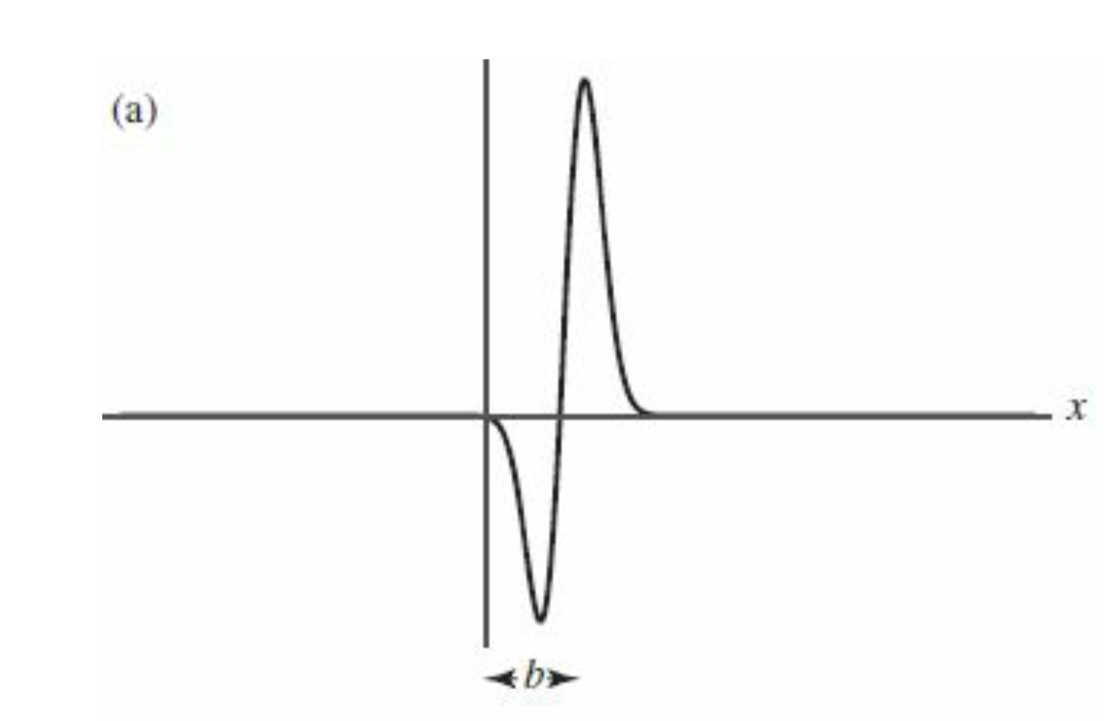
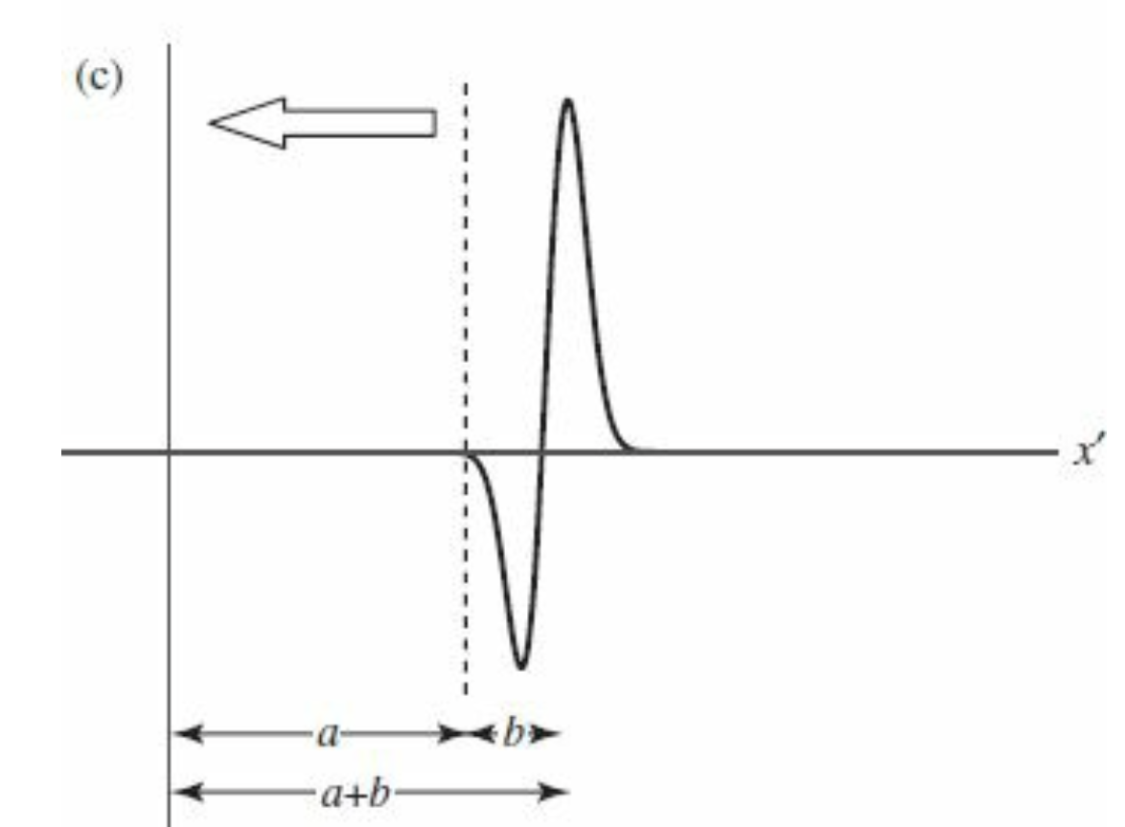
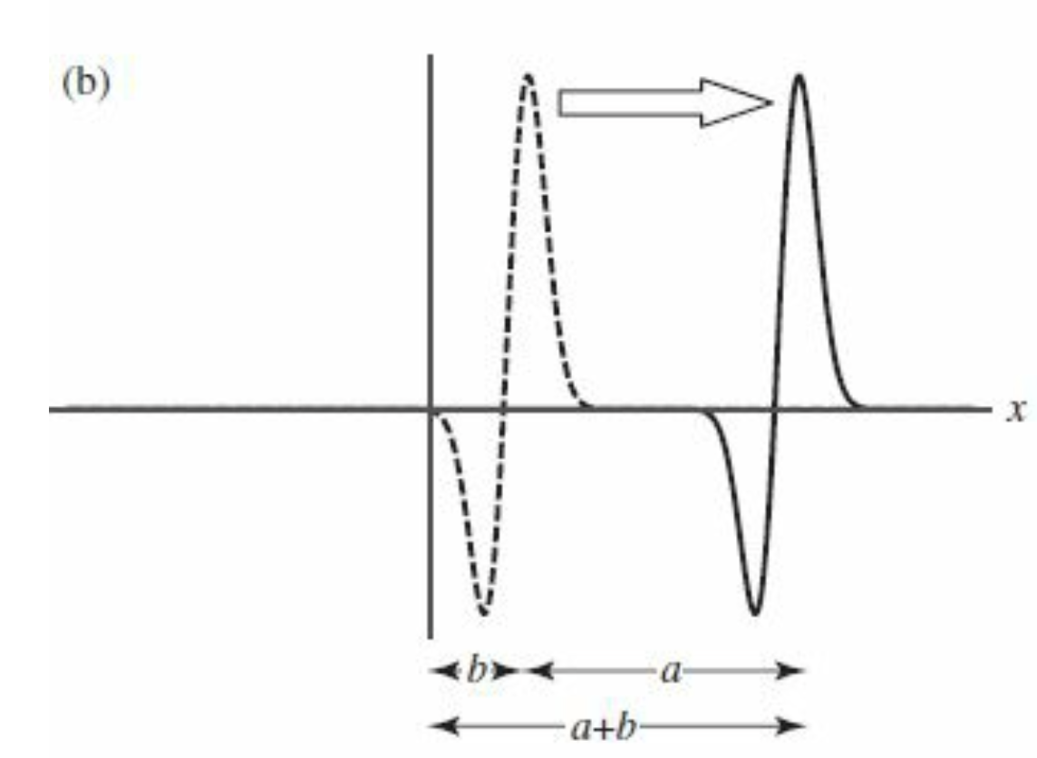
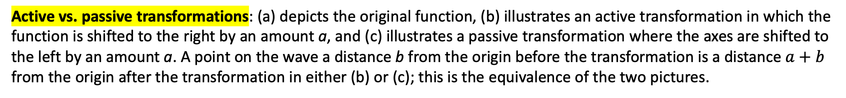
Example 1: $\hat{Q}$= $\hat{x}$
Active vs. passive transformations: (a) depicts the original function, (b) illustrates an active transformation in which the function is shifted to the right by an amount a, and (c) illustrates a passive transformation where the axes are shifted to the left by an amount a. A point on the wave a distance b from the origin before the transformation is a distance $a+b$ from the origin after the transformation in either (b) or (c); this is the equivalence of the two pictures.

Slide 10
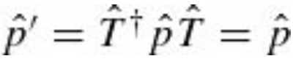
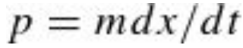
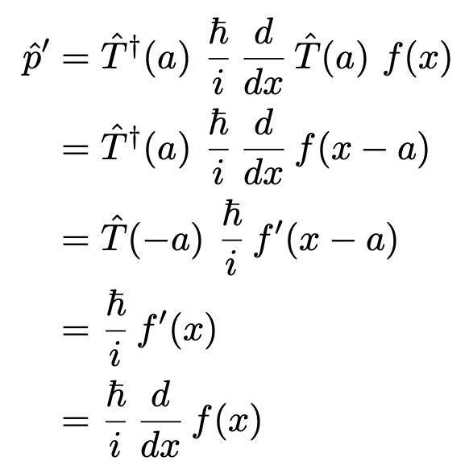
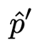
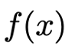
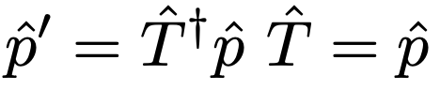
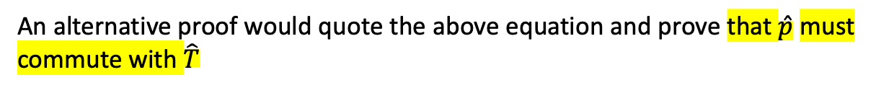

Example 2: $\hat{Q}$= $\hat{p}$
One can apply a translation to the momentum operator and show that $\hat{p}$is left invariant
That is, the momentum operator is unchanged by this transformation. Physically, this is because the particle’s momentum
is independent of where you place the origin of your coordinates, depending only on differences in position
To see that the first formula is true, we consider how the operator $\hat{p}$ acts on an arbitrary function $f(x)$
An alternative proof would quote the above equation and prove that $\hat{p}$must
commute with $\hat{T}$
Which is always satisfied as $\hat{T}$ is unitary. Therefore, if $\hat{p}$and $\hat{T}$commute, then

Slide 11
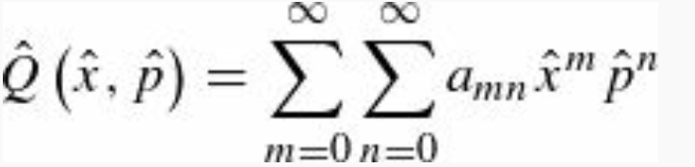
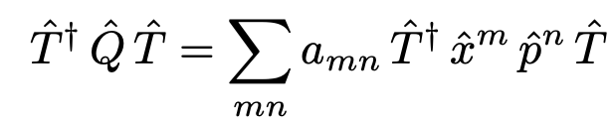
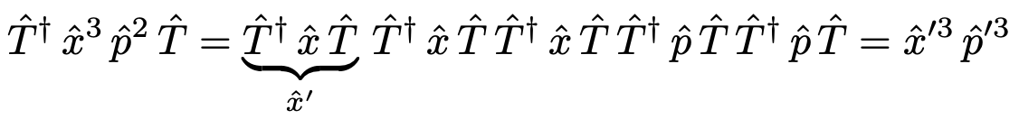
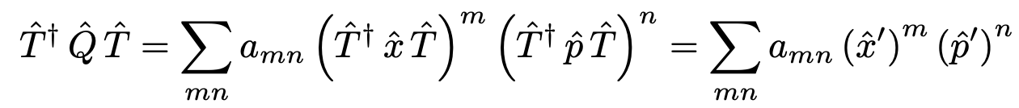
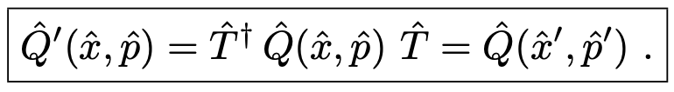


Example 2: $\hat{Q}$ general
Once we know how the position and momentum operators behave under a translation, we know how any operator does,
since one can always write
To prove this result, we can assume that $\hat{Q}(\hat{x},\hat{p})$ has a representation as a series expansion with constant coefficients $a_{mn}$
We start by writing
Then, the idea is that we’re then free to insert copies of $\hat{T}$ $\hat{T}$† $= 1$ wherever necessary, for example:
Then it’s clear that

Slide 12
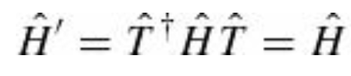
Translational Symmetry
So far, we have seen how a function behaves under a translation and how an operator behaves under a translation.
We are now in a position to make precise the notion of a symmetry that we mentioned in the introduction.
A system is translationally invariant (equivalent to saying it has translational symmetry) if the Hamiltonian is unchanged by the transformation
Because $\hat{T}$ is unitary, we can multiply both sides of this equation by $\hat{T}$
which means that the Hamiltonian commutes with $\hat{T}$. Therefore, a system has translational symmetry if the
Hamiltonian commutes with the translation operator:

Slide 13
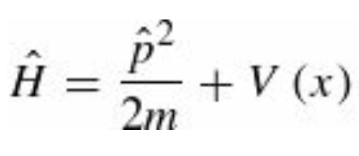
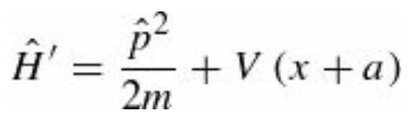
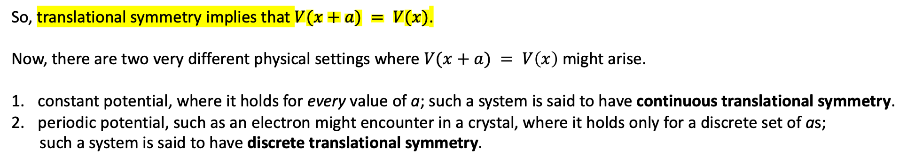
Translational Symmetry
For a particle of mass m moving in a one-dimensional potential, the Hamiltonian is
The transformed Hamiltonian is
So, translational symmetry implies that $V(x+a) = V(x)$.
Now, there are two very different physical settings where $V(x+a) = V\left(x\right)$ might arise.
constant potential, where it holds for every value of a; such a system is said to have continuous translational symmetry.
periodic potential, such as an electron might encounter in a crystal, where it holds only for a discrete set of as;
such a system is said to have discrete translational symmetry.

Slide 14


Translational Symmetry
Potentials for a system with continuous (left) and discrete (right) translational symmetry. In the former case the potential is the same when shifted right or left by any amount; in the latter case the potential is the same when shifted right or left by an integer multiple of a.

Slide 15




Discrete Translational Symmetry and Bloch’s Theorem
What are the implications of translational symmetry? For a QM system with a discrete translational symmetry, the most important consequence is Bloch’s theorem. The theorem specifies the form taken by the stationary states. Let’s prove it.
We learned that if two operators commute, then they have a complete set of simultaneous eigenstates. This means that if the Hamiltonian is translationally invariant (which is to say, if it commutes with the translation operator), then the eigenstates $ψ(x)$ Hamiltonian can be chosen to be simultaneously eigenstates of $\hat{T}$
$λ$ is the eigenvalue associated to $\hat{T}$. Since $\hat{T}$ is unitary, $λ$ can be written as $λ=e^{iφ}$ for some real number $φ$. In solid state
Physics the convention is to set $φ=−(q a)$ where $ℏq$ is the crystal momentum. Therefore, the stationary states of a particle
of mass m moving in a periodic potential have the property
Is a more illuminating way of writing the equation above (and that’s Bloch’s theorem).

Slide 16


Discrete Translational Symmetry and Bloch’s Theorem
Bloch’s theorem
Substituting this expression in we obtain
Here, $u(x)$ is a periodic function of $x$: $u(x−a) = u(x)$ and $e^{iqx}$ is a travelling wave (recall that a travelling wave by itself
describes a free particle) with wavelength $2π/q$.
Bloch’s theorem says that the stationary states of a particle in a periodic potential are periodic functions multiplying
traveling waves. Note that just because the Hamiltonian is translationally invariant, that doesn’t mean the stationary
states themselves are translationally invariant, it simply means that they can be chosen to be eigenstates of the translation
operator.
Bloch’s theorem is truly remarkable. It tells us that the stationary states of a particle in a periodic potential
(such as an electron in a crystal) are, apart from a periodic modulation, traveling waves.
As such, they have a nonzero velocity.
This means that an electron could travel through a perfect crystal without scattering!
That has dramatic implications for electronic conduction in solids.

Slide 17

Discrete Translational Symmetry and Bloch’s Theorem

Slide 18



Continuous Translational Symmetry and Momentum Conservation
If a system has continuous translation symmetry, then the Hamiltonian commutes with $\hat{T}(a)$ for any choice of $a$.
In this case it is useful to consider an infinitesimal translation
where δ is an infinitesimal length. If the Hamiltonian has continuous translational symmetry, then it must be unchanged
under any translation, including an infinitesimal one; equivalently it commutes with the translation operator, and hence
So, if the Hamiltonian has continuous translational symmetry, it must commute with the momentum operator. And if the
Hamiltonian commutes with momentum, then according to the “generalized Ehrenfest’s theorem”:

Slide 19

Continuous Translational Symmetry and Momentum Conservation
Important observation related to infinitesimal transformations
For the case of continuous symmetries, it is often much easier to work with the infinitesimal form of the transformation; any finite transformation can then be built up as a product of infinitesimal transformations. In particular, the finite translation by a is a sequence of N infinitesimal translations with $δ=a/N$ in the limit that $N→∞$

